Slide 1



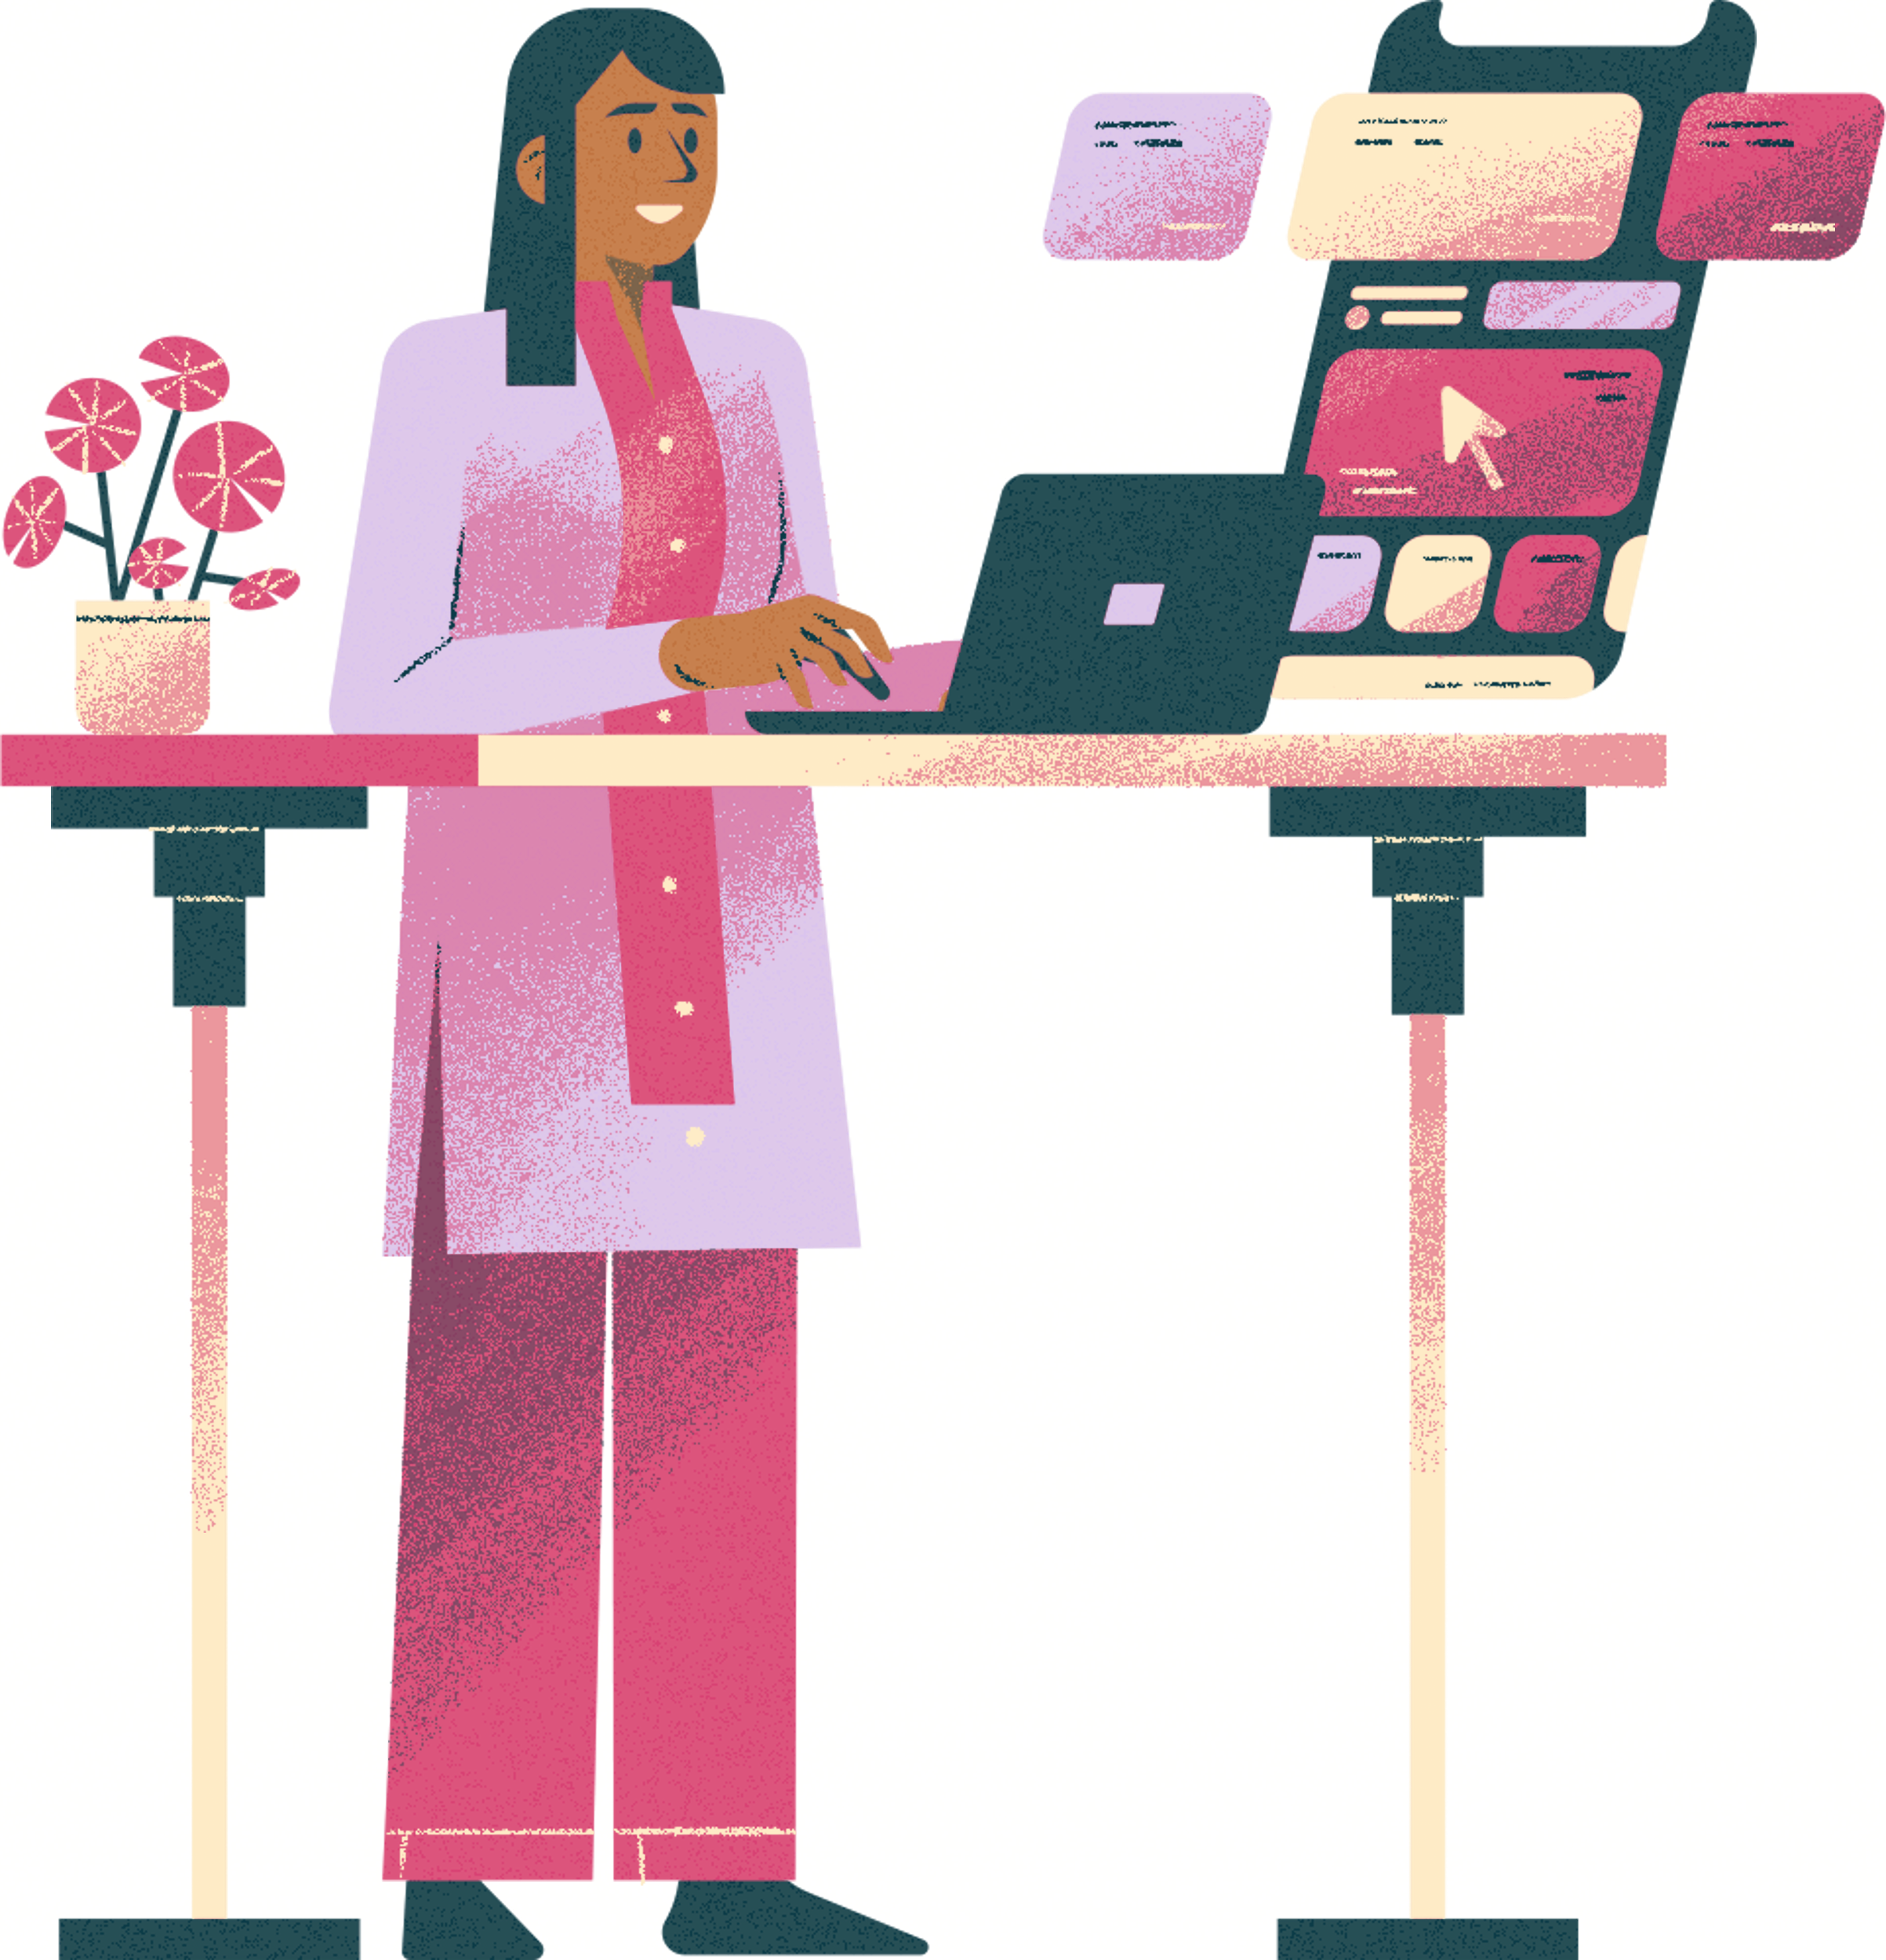


FAURECIA
FORVIA
Comms App
Project Presentation

Slide 2




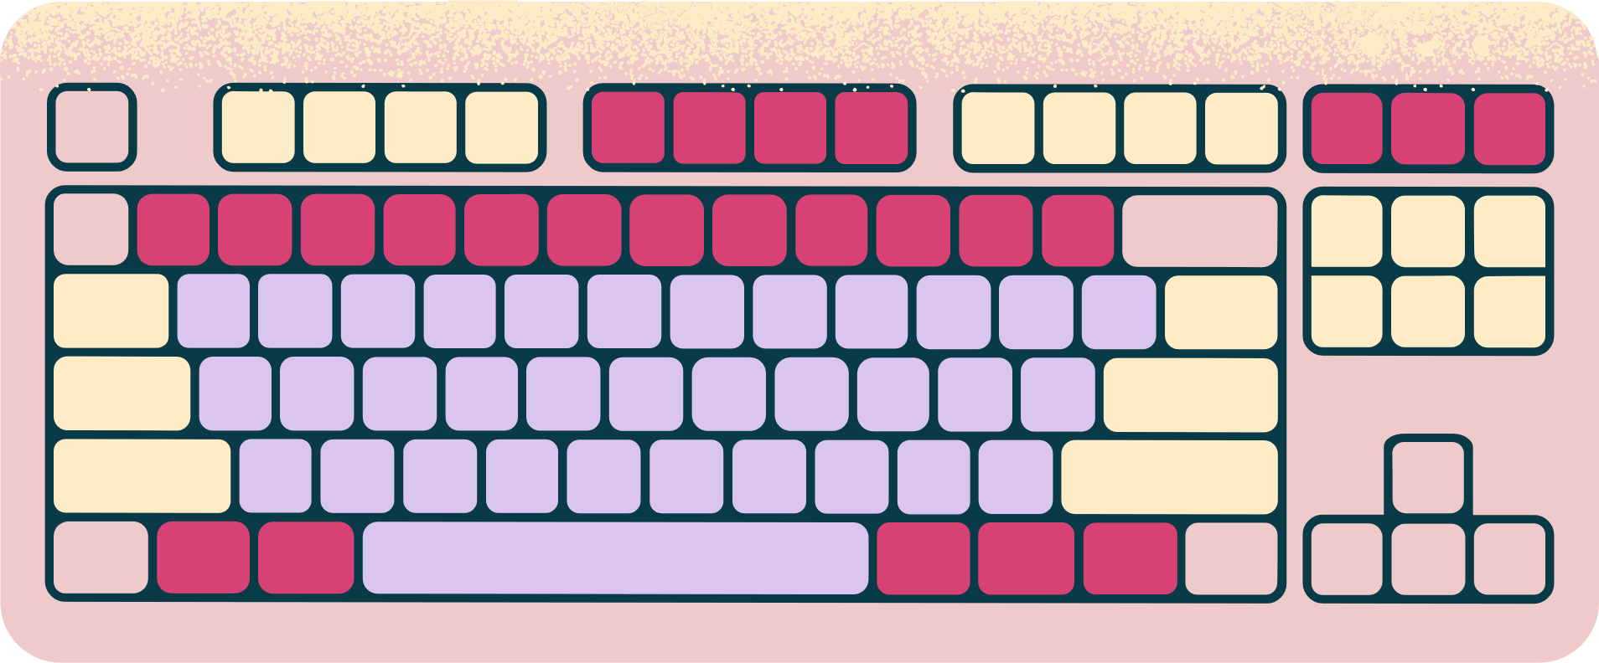
FAURECIA
FORVIA
TABLE OF CONTENTS
01
02
About me
Problems
Who am I ?
Why do we need Comms ?
03
04
Process
Usage
How did the process go ?
How to user Comms App ?

Slide 3



FAURECIA
FORVIA
01
ABOUT ME
My name is Ege (21) and I am an intern at the IT departmant of Faurecia FORVIA. I also am a computer engineering student at IZTECH in İzmir.

Slide 4


FAURECIA
FORVIA
02
PROBLEMS
Introducing our Comms App, a a user friendly app to manage hangouts or meetings that can be used either in daily-life or work-life. Our app offers ease of use by simply gathering many users in a single room to notify all users that a hangout/meeting has been posted by another user that they should either reject or accept.

Slide 5






Development Map
Initial Prototypes
And Digital Mockups
Connecting Front and Backend, Testing
Initial Digitalization of Prototypes
Optimazing, Final UI Versions
Setting Up the Firebase Backend Services
1st Release of Comms

Slide 6

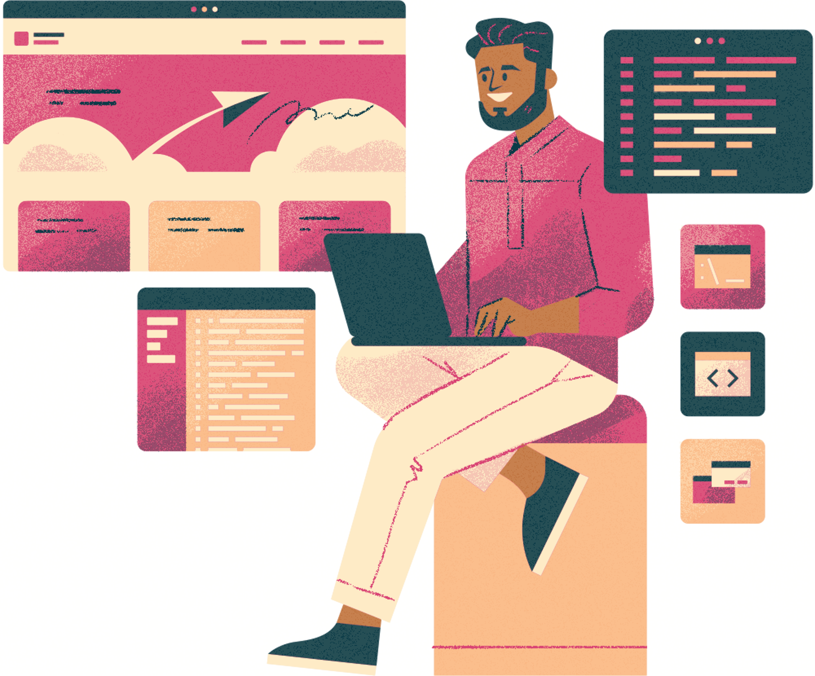

FAURECIA
FORVIA
03
PROCESS
Main goal of Comms App is to ease the planning part of the meetings/hangouts by notifieing all users as soon as the meeting/hangout is created. This way the users will now who is coming and who is not thus, they can plan accordingly.

Slide 7

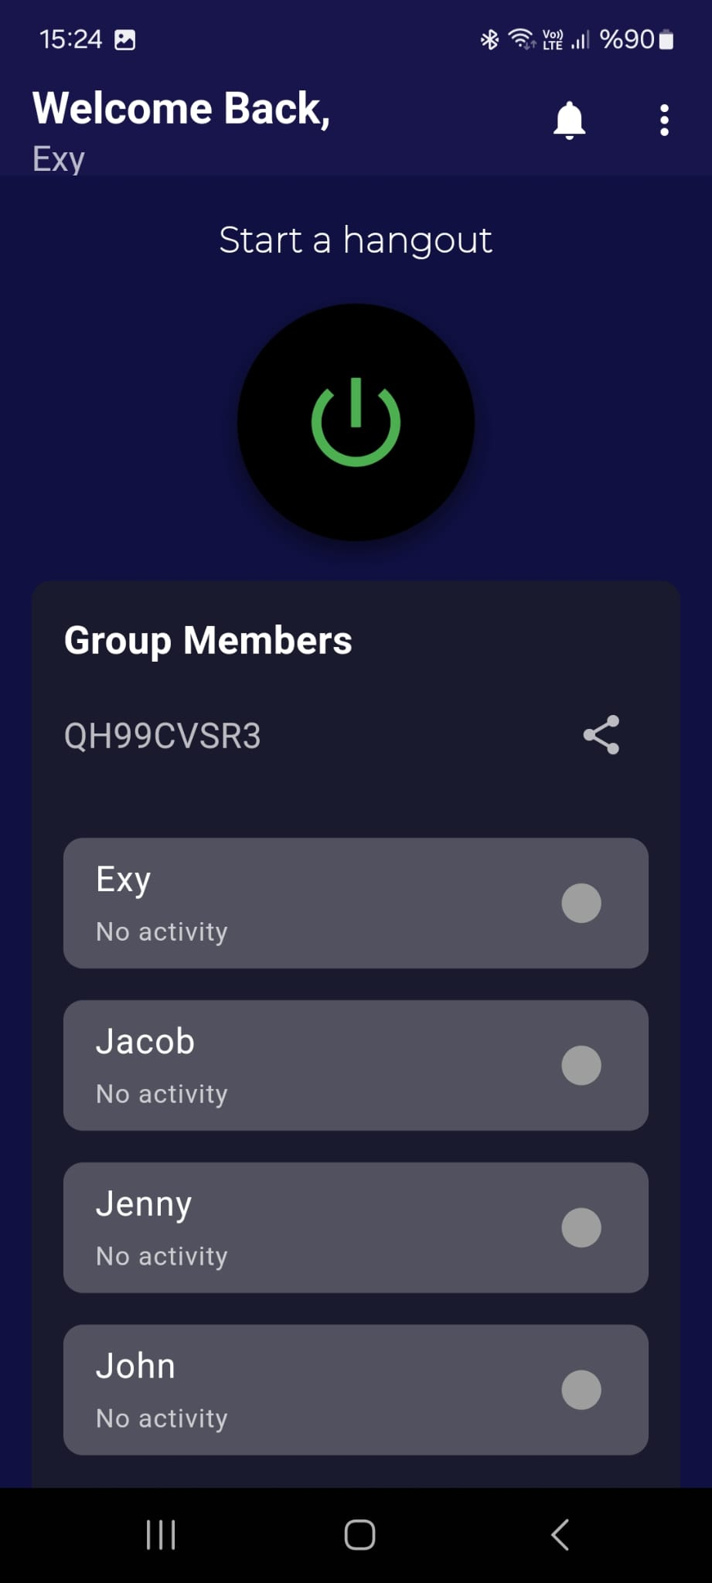
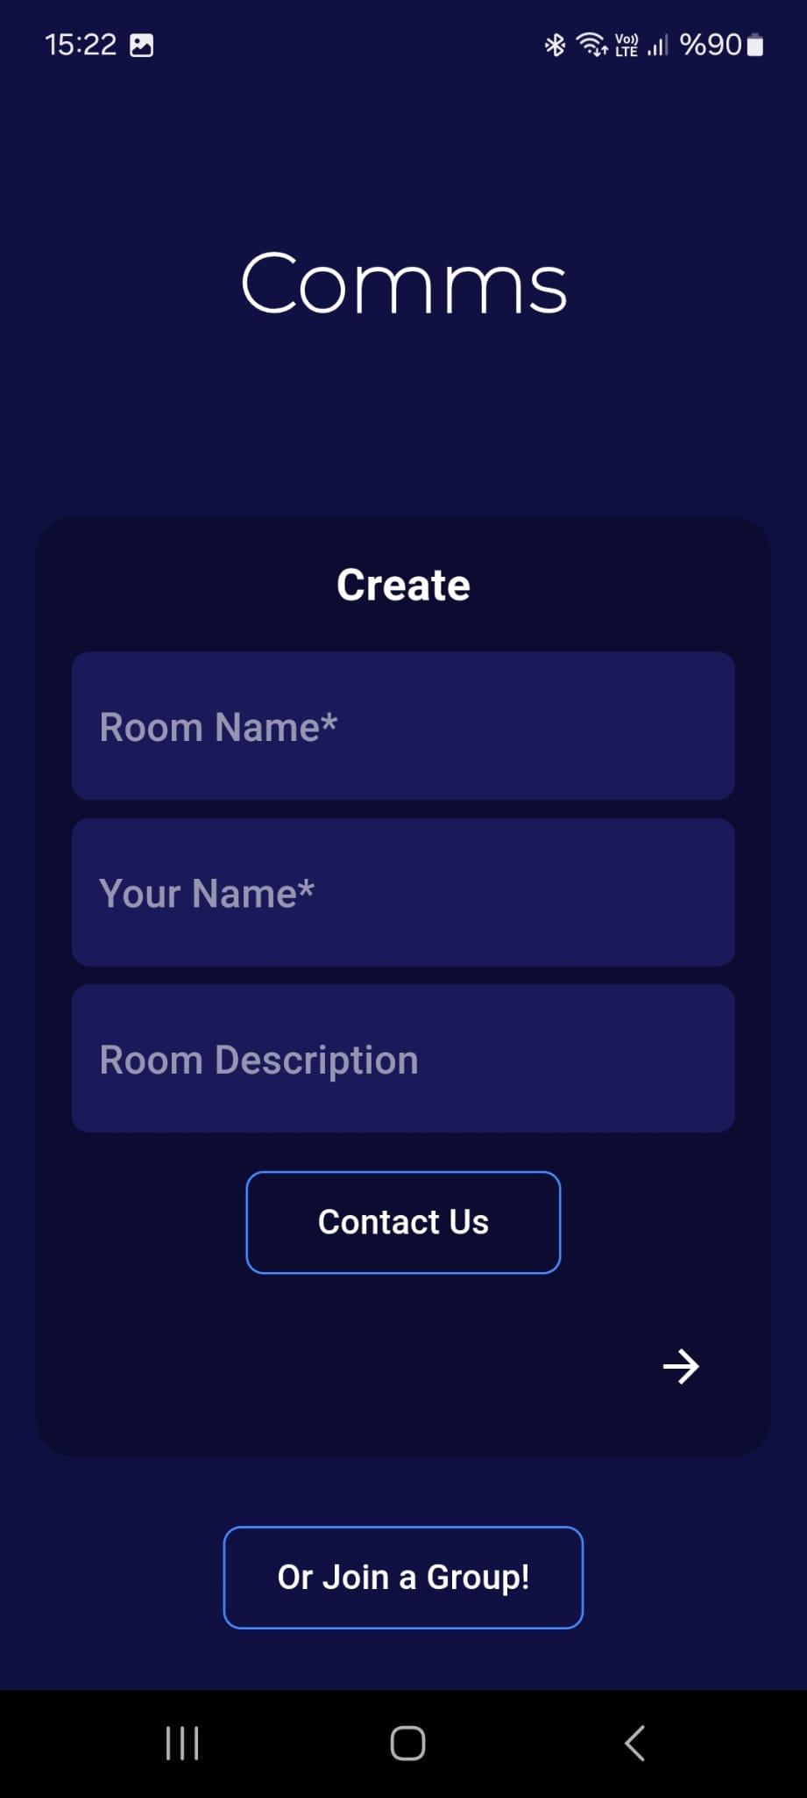

FAURECIA
FORVIA
How to Use
Getting Into a Room
Click «Create Room» to create a room with a descriptions and enter your name to proceed. It is also possible to join a already existing room via the «Join Button» (If you know the code of course).
Setting Up a Meeting
Click the power button at the center of the page to enter the details of the meeting. Other users will be notified and prompted to either reject or accept your meetings. Their decisions will be shown both as a test under their user name and a color indicating what decision they made.
Features
Comms also enables users to cancel a meeting to open up a new one if neccessary. They can see which hangout is cancelled and when inside the app. If needed users can exit their room to get into another one.

Slide 8



FAURECIA
FORVIA
YOUR PROJECT
Presentations are communication tools that can be used as demonstrations, lectures, speeches, reports, and more. It is mostly presented before an audience. It serves a variety of purposes, making presentations powerful tools for convincing and teaching.
YEAR: 2022
ROLE: WRITE YOUR ROLE

Slide 9


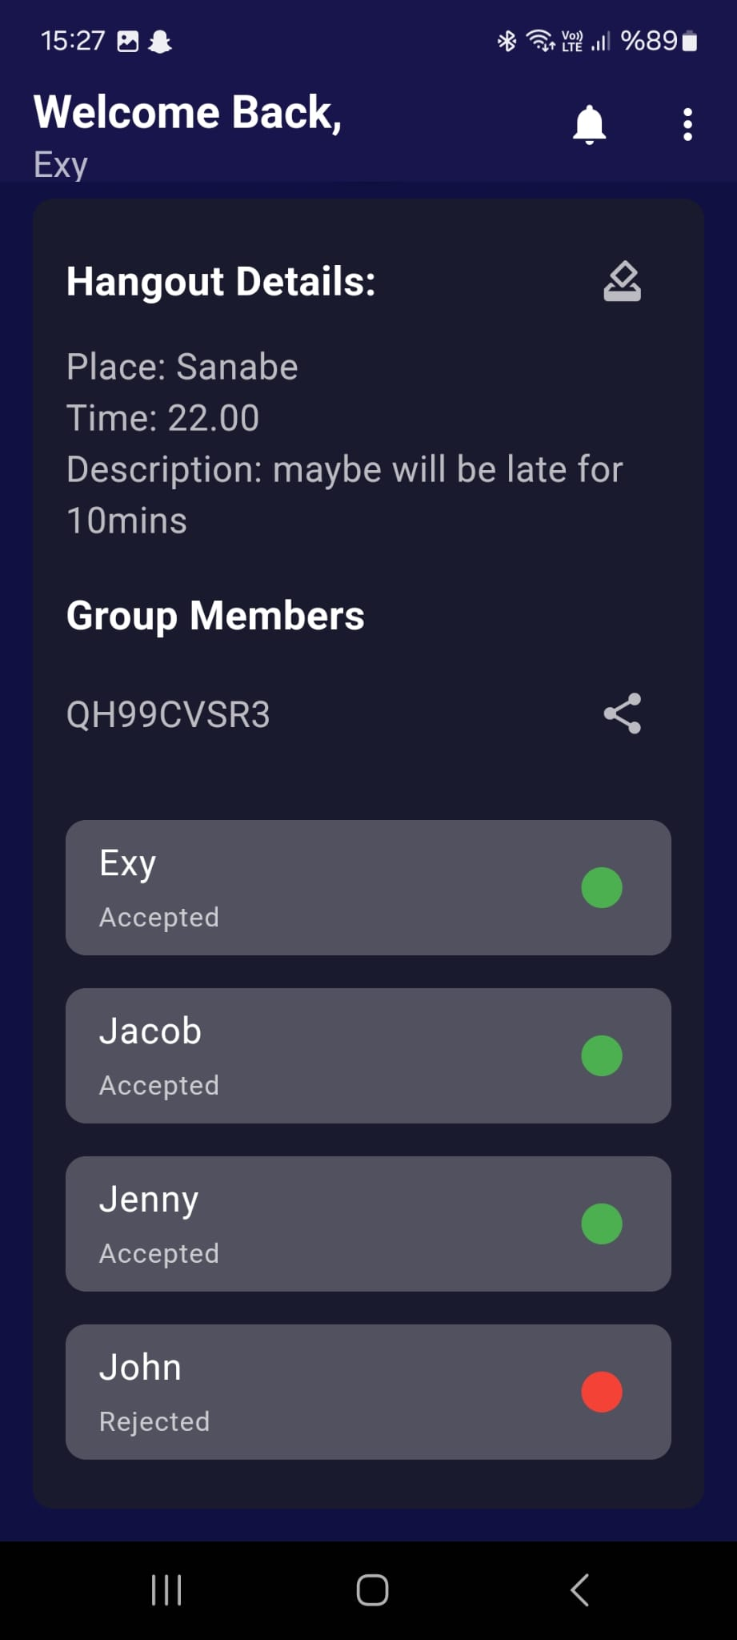
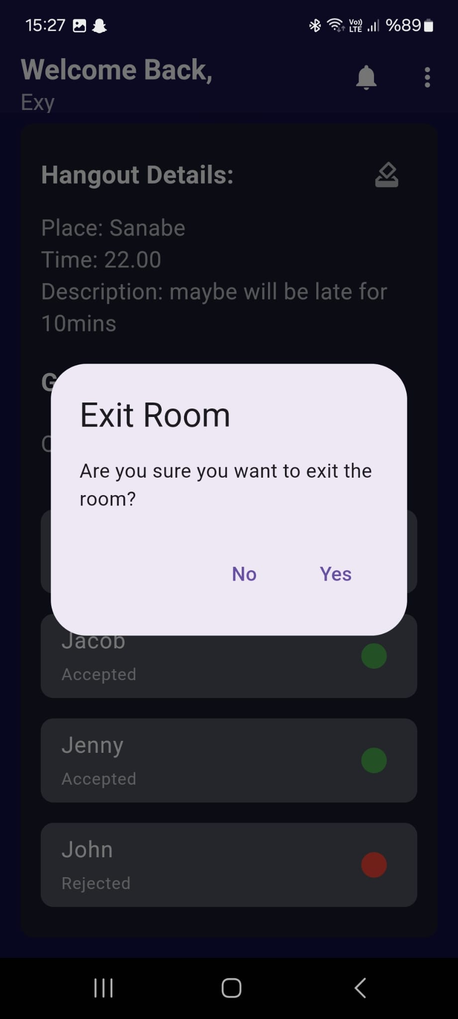
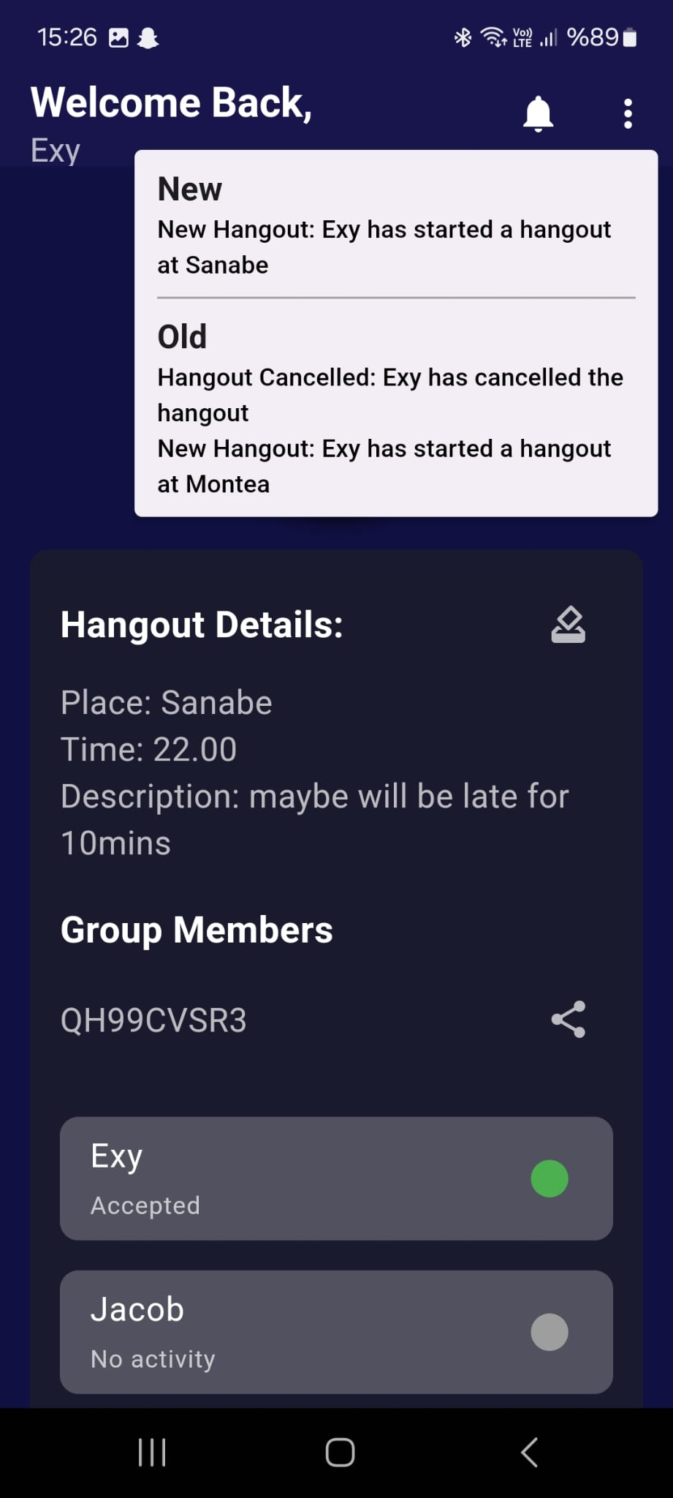
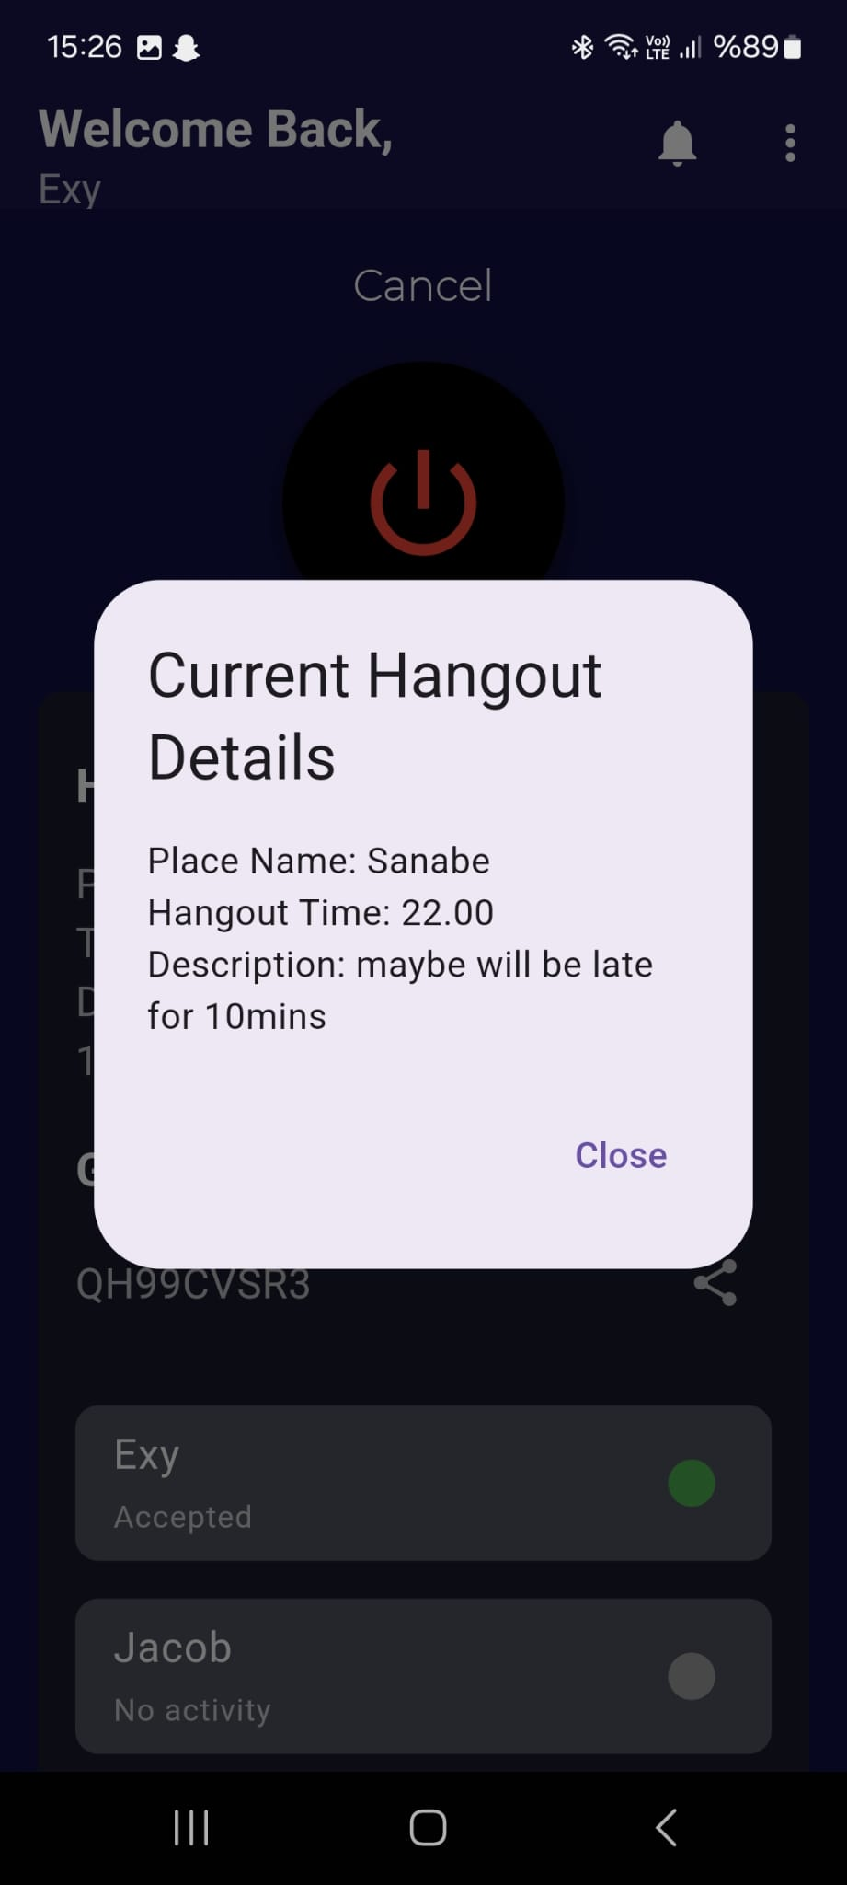


UI’s
FAURECIA
FORVIA

Slide 10

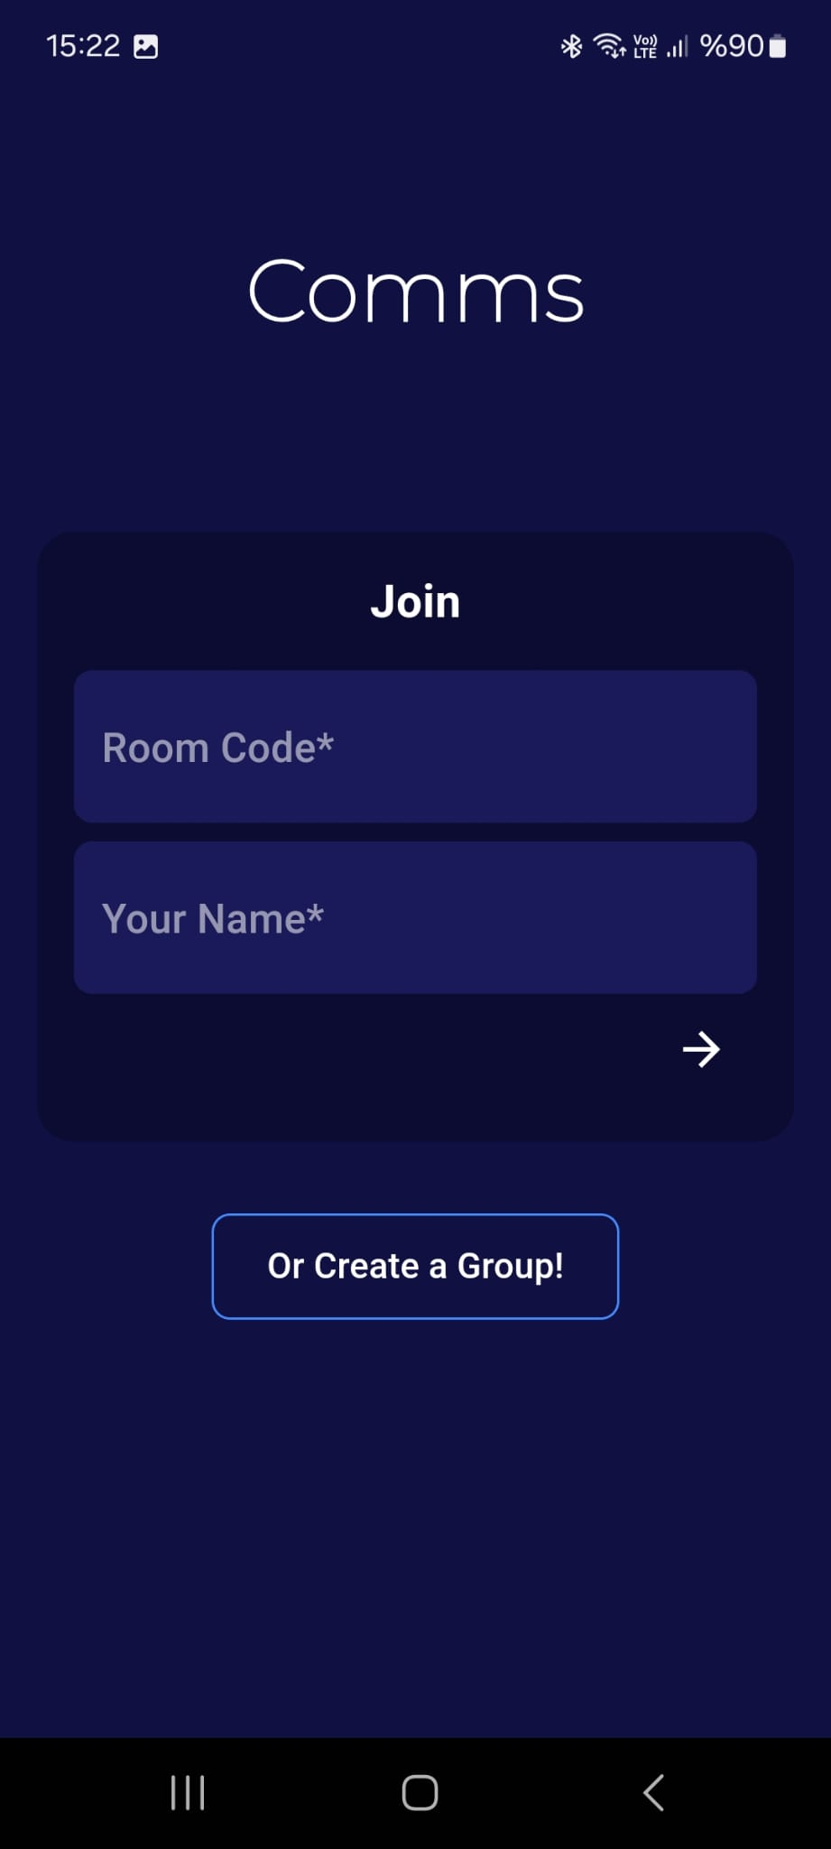

Slide 11
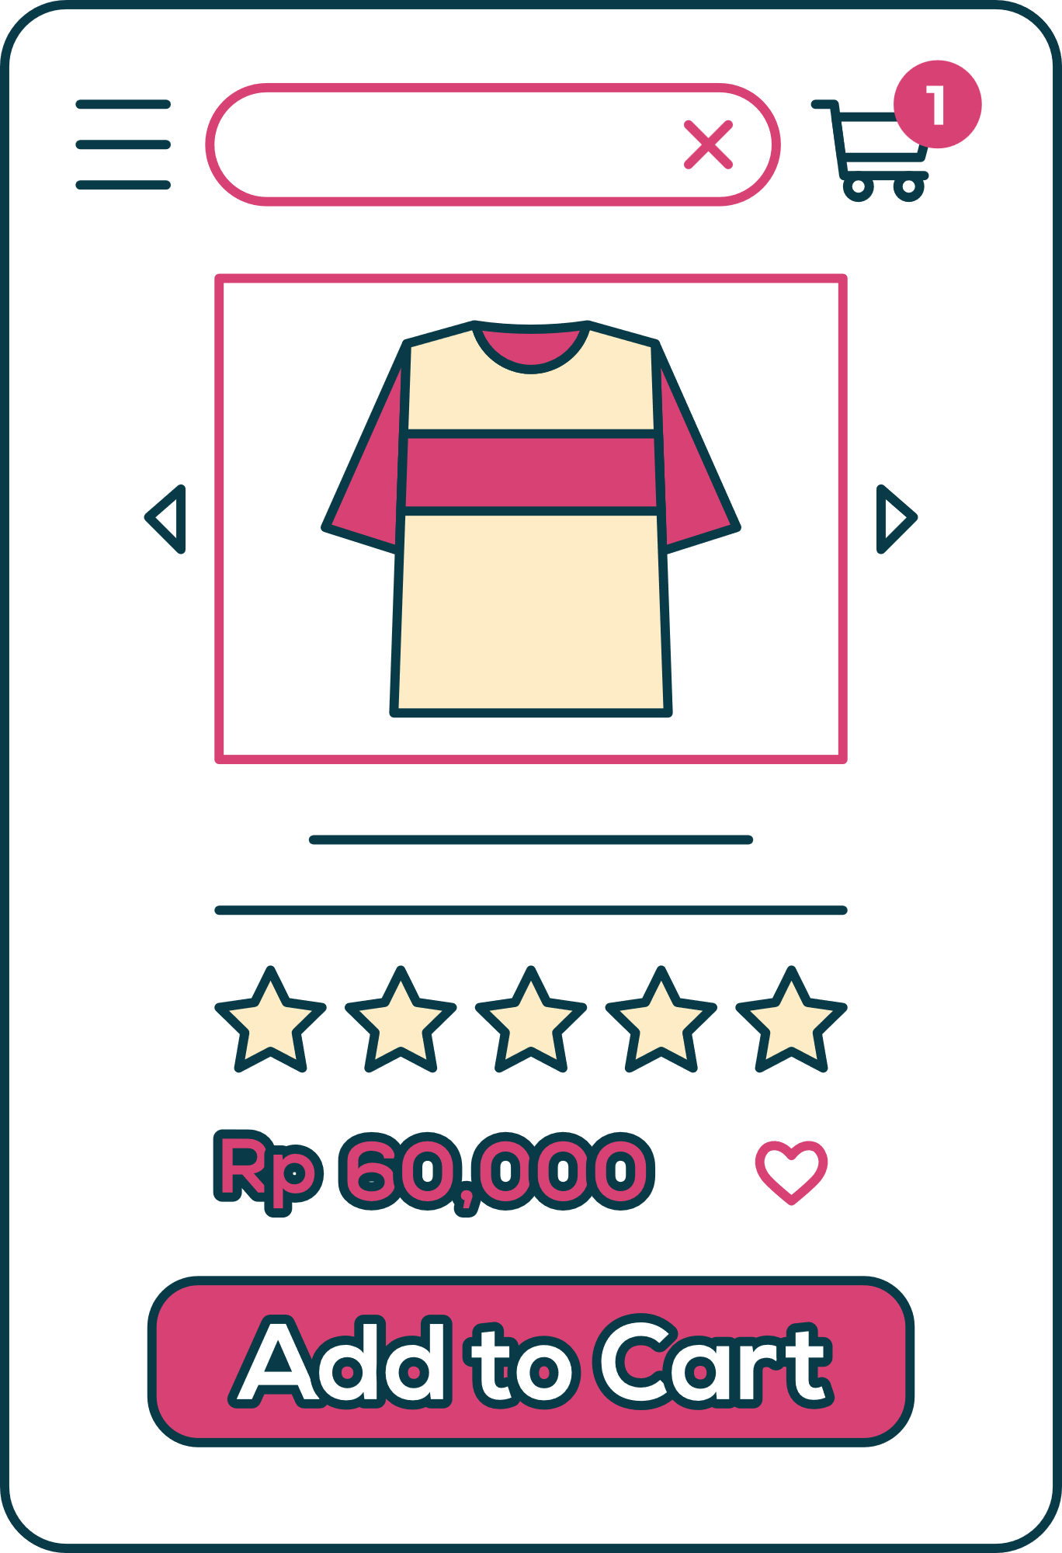

FAURECIA
FORVIA
COMPETITORS
Your app
Strengths: Known for their extensive product range and established brand reputation.
Weaknesses: Limited customization options and lack of personalized service.
Opportunities: Expanding into new markets and diversifying their product offerings.
Threats: Increased competition from emerging players and shifting consumer preferences.
Your app
Strengths: Known for their extensive product range and established brand reputation.
Weaknesses: Limited customization options and lack of personalized service.
Opportunities: Expanding into new markets and diversifying their product offerings.
Threats: Increased competition from emerging players and shifting consumer preferences.

Slide 12


THANK YOU!

Slide 13
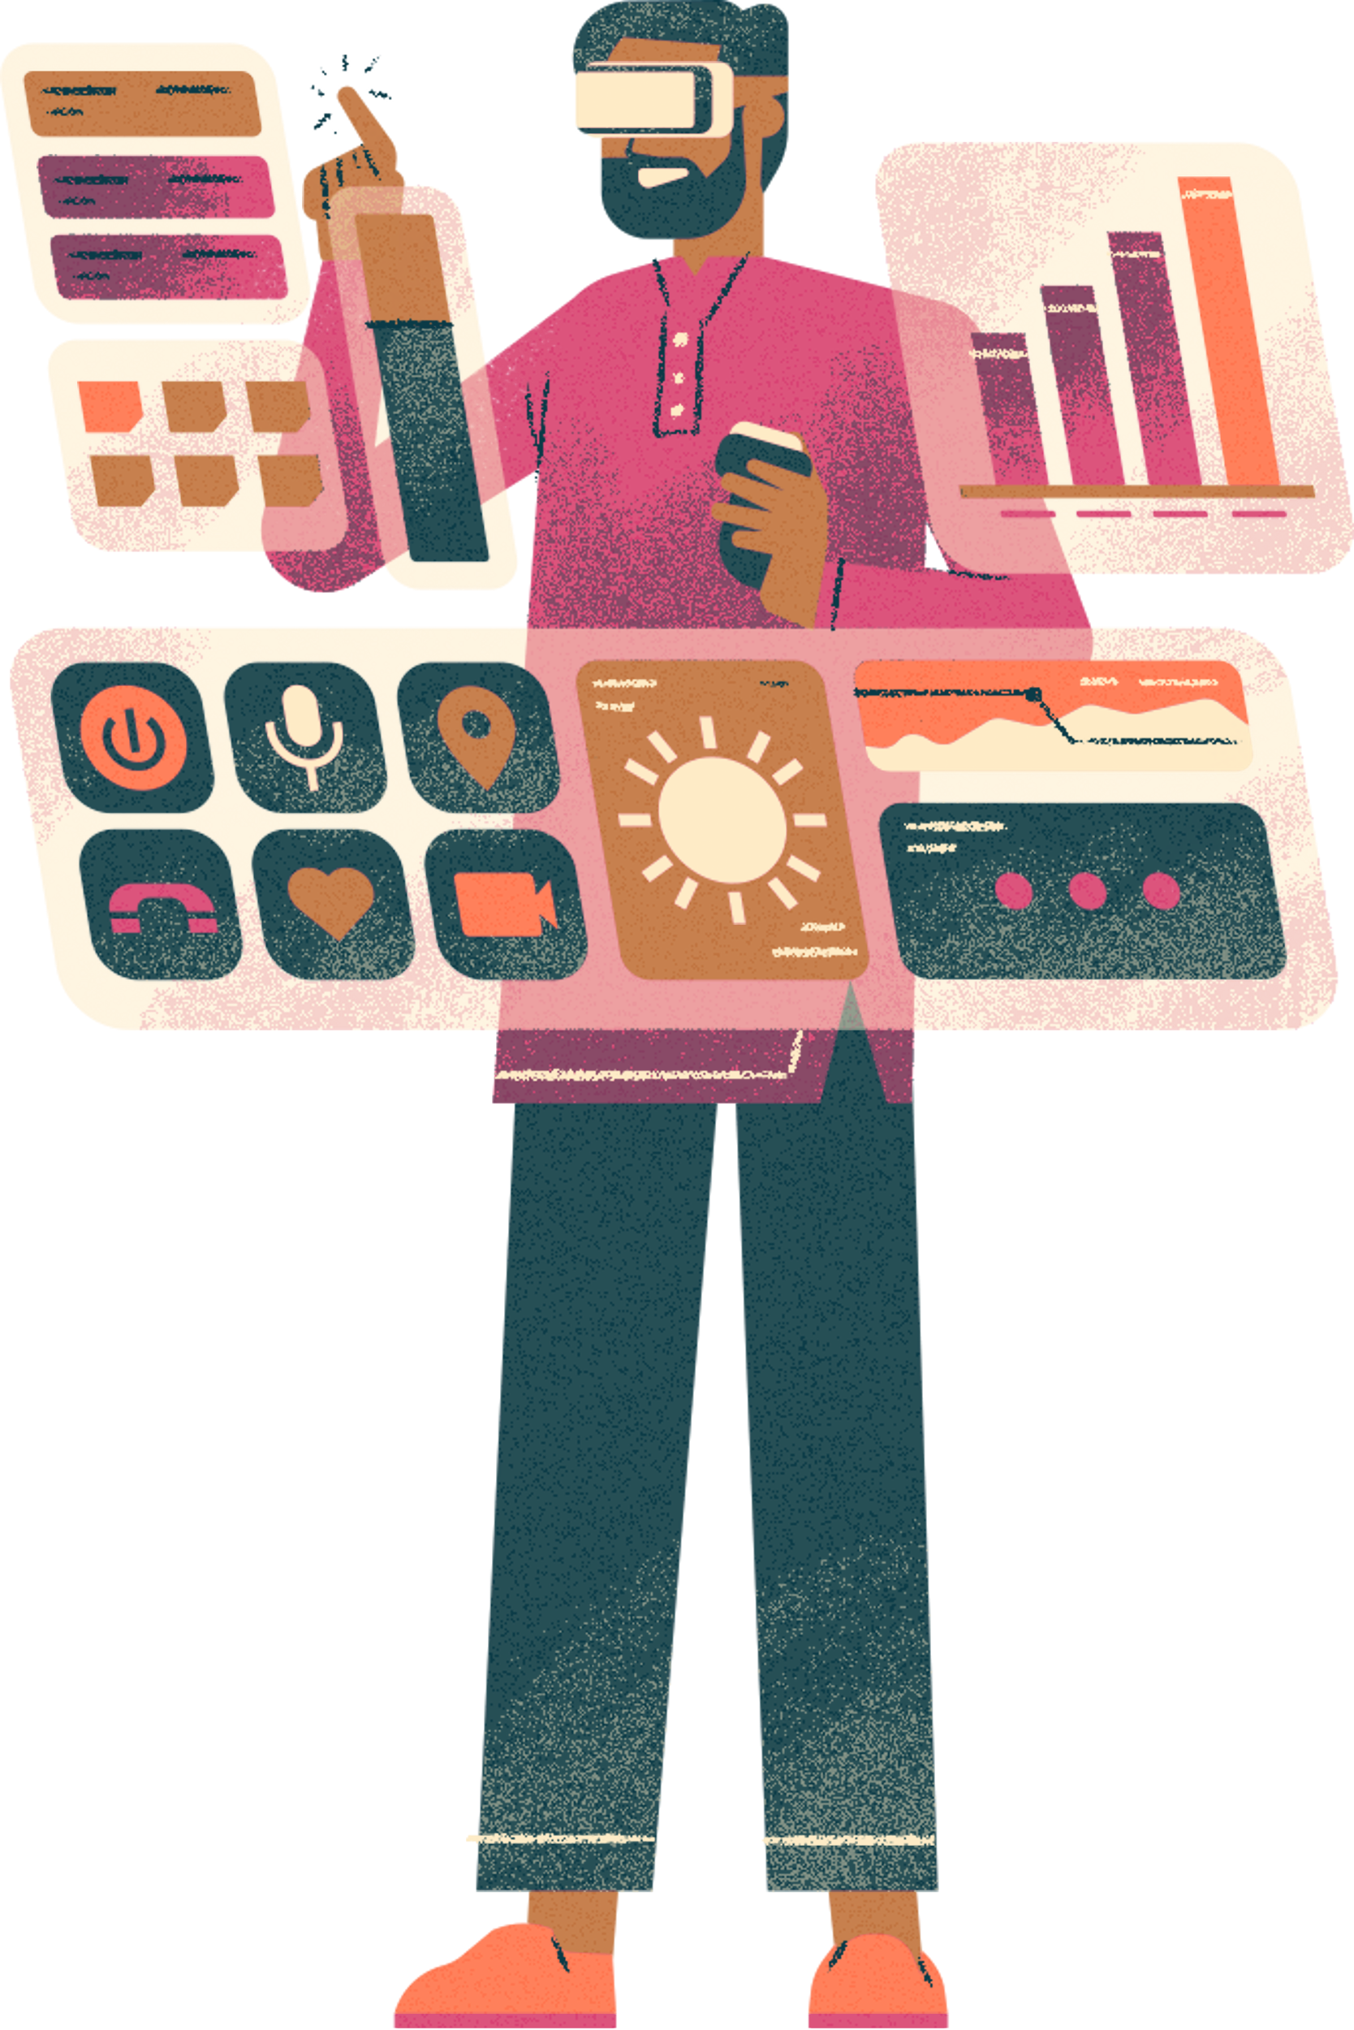


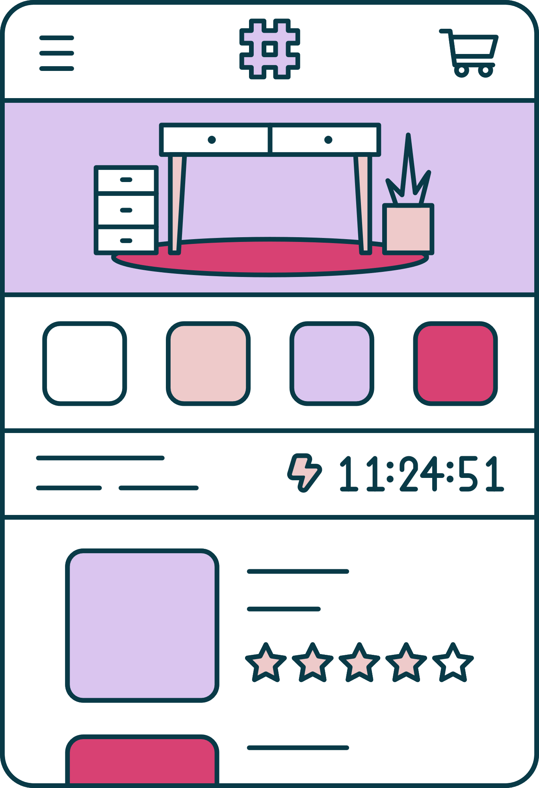
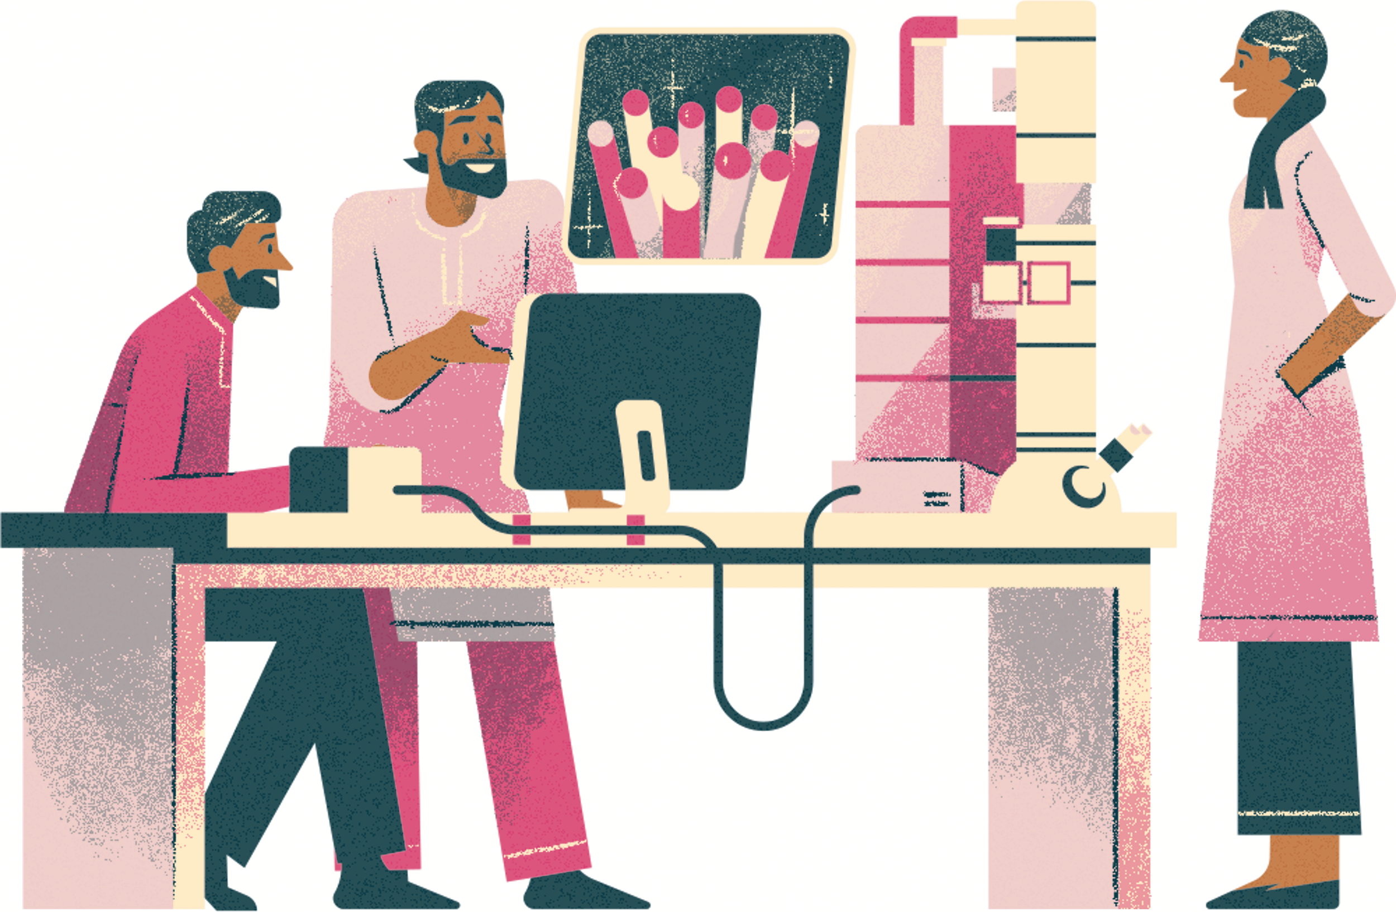




RESOURCE
PAGE
Use these design resources in your Canva Presentation.
You can find these fonts online too.
Happy designing!
Don't forget to delete this page before presenting.
This presentation template uses the following free fonts:
Titles:Gliker Expand
Headers: Proxima Nova
Body Copy: Proxima Nova

